Slide 1
AI Governance
Chapter 04

Slide 2
Why AI Governance Matters?
Rapid adoption of AI tools and agents
Increased legal and compliance exposure

Slide 3
Legal and Compliance Considerations
AI use may be regulated or restricted
Requirements vary by organization and industry

Slide 4
Documenting How AI is Used
Some organizations require disclosure
Identifies AI tools used and for what purpose

Slide 5
AI Usage Restrictions and Polices
AI use may be restricted by industry regulations
Organizations define acceptable AI use through policy
Policies specify approved tools and prohibited uses

Slide 6
Sensitive Data Risks and AI Data Leakage
Sensitive data may be submitted to AI systems
Data can become part of the AI model
Other users or organizations may retrieve it

Slide 7
AI Risk
Chapter 04

Slide 8
Risk of Using AI
AI introduces accuracy, security, and trust risks
Risks must be understood before adoption

Slide 9
Common AI Risks
Hallucinations
Data exposure
Model poisoning
Malicious prompts

Slide 10
AI Hallucinations
AI presents false information as fact
No supporting evidence for the output

Slide 11
Data Exposure Risks and AI Data Leakage
Data submitted to AI may become part of the model
Sensitive information may be exposed to others

Slide 12
Model Poisoning
Attackers manipulate training data or behavior
Produces biased, incorrect, or attacker-controlled results

Slide 13
Malicious Prompts
Inputs designed to bypass AI safeguards
Can leak data or trigger unsafe actions

Slide 14
AI Use
Chapter 04

Slide 15
Common AI Use Cases
Data comparison and analysis
Log file analysis
Document creation
Incident investigation
Automation and orchestration

Slide 16
Data Analysis and Log File Analysis
AI quickly analyzes large data sets
Converts complex logs into human-readable summaries

Slide 17
Document Creation
Provides a starting point for documentation
Assists with routine reports and summaries

Slide 18
Incident Investigation and Event Correlation
Ingests multiple data sources
Identifies suspicious or malicious activity across systems

Slide 19
Automation and Orchestration
Automatically responds to incidents
Executes predefined response actions and scripts

Slide 20
Automation - Integration
Chapter 04

Slide 21
Automation and APIs
Automation increases with complexity
APIs enable system interaction
Interface for predefined actions

Slide 22
AI Concept Example
Structured interface for tasks
Limited predefined operations
Not full system access

Slide 23
APIs in Modern Platforms
Programmable interfaces for applications
Enable automation and integration
Common in web platforms

Slide 24
Webhooks
Automated HyperText Transfer Protocol (HTTP) messages
Notify clients of changes
Browser callback behavior

Slide 25
The Polling Model
Repeated update requests
Continuous change checking
High overhead

Slide 26
Webhooks vs Polling
Webhooks
Push updates on change
Polling
Constant pull requests
Reduced overhead with webhooks

Slide 27
Plugins Extending Functionality
Add features to tools
Extend base product
Not included by default

Slide 28
Plugin Integration and Licensing
Use APIs for interaction
Free or pain options
Separate licensing possible

Slide 29
Automation - Scripting
Chapter 04

Slide 30
Shell Scripting Overview
Oldest scripting type
Built into Linux and Unix
Executes ordered or conditional commands
Supports branching based on input

Slide 31
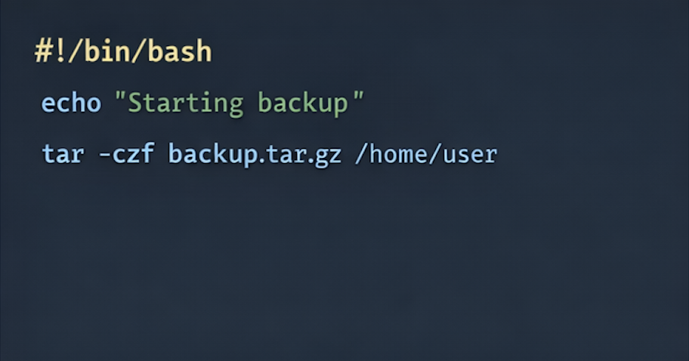
Identifying a Shell Script
Begins with a shebang (#!)
Points to interpreter
Example: /bin/bash
Variables often uppercase

Slide 32
Python Scripting Characteristicis
Widely used in organizations
Easy to read syntax
Large library ecosystem
No semicolons

Slide 33
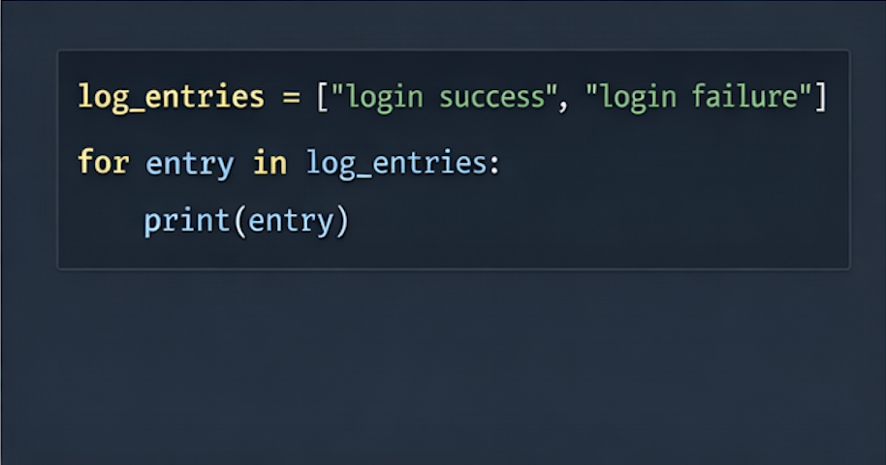
Python Formatting and Readability
Uses whitespace formatting
Structure based on indentation
Reduces syntax errors
Improves readability

Slide 34
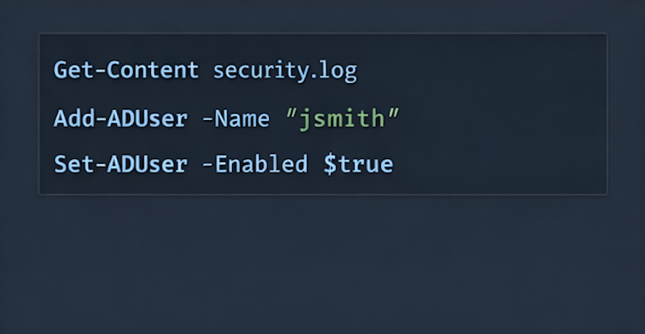
PowerShell Overview
Built into Windows
Command-line automation tool
Similar to shell scripting
Used for system management

Slide 35
PowerShell Verb-Noun Syntax
Commands use verb-noun format
Verb
Get, add, set
Noun
User, content, group
Example commands
get-content
add-user
Identifies PowerShell scripts

Slide 36
Response Standards
Chapter 04

Slide 37
Consistency in Incident Response
Consistency ensures secure systems
Prevents gasps in protection
Standardizes response across teams
Ensures incidents are handled correctly

Slide 38
Standardized Response Processes
Standard process guide actions
Enable coordination across teams
Apply regardless of responder
Ensure consistent outcomes

Slide 39
Standard Operating Procedures (SOPs)
Define how situations are handled
Provide structured response steps
Support team coordination
Ensure consistent execution

Slide 40
Guardrails in Reponse
Guide employee actions
Allow flexibility in execution
Define boundaries for decisions
Balance control and autonomy

Slide 41
Playbooks vs Runbooks
Playbooks
Team response procedures
Runbooks
Individual task guidance
Both provide step-by-step actions
Support coordinated response

